Slide 1
FOR INTERNAL USE ONLY
Invision prototype tool demo - Agile Apps and Analytics MI
Mandy Cadman, Saransh Bansal
Information classiﬁcation: Internal

Slide 2
Agile Apps F&SA
Is a bespoke
App development environment
where internal web applications are
Designed, Built and Hosted
to solve
Operational problems
for Bank internal customers

Slide 3
Analytics MI
Are Data visualisations served as Tableau dashboards to help bring data to life using analytical insights

Slide 4
Pain-point
Capturing stakeholder requirements and feedback from the outset efficiently reducing rework where possible

Slide 5

What is Invision
FOR INTERNAL USE ONLY
Allows design teams to create interactive prototypes of web and mobile applications and gather instant feedback from key stakeholders through social and collaborative capabilities.
Large interest in multiple areas in Natwest group as the go to tool for UI design collaboration.
Information classiﬁcation: Internal

Slide 6
Proposed Agile Apps design operating model
Confluence, JIRA
Balsamiq Mockups
Static wireframe mock-up screens
InVision prototype
Interactive wireframe prototype
Initial requirements gathering
Stakeholder feedback
Comments
Updating Balsamiq wireframe mock-ups
Addressing feedback
Marking comments as resolved
Updating the live prototype
Freehand

Slide 7
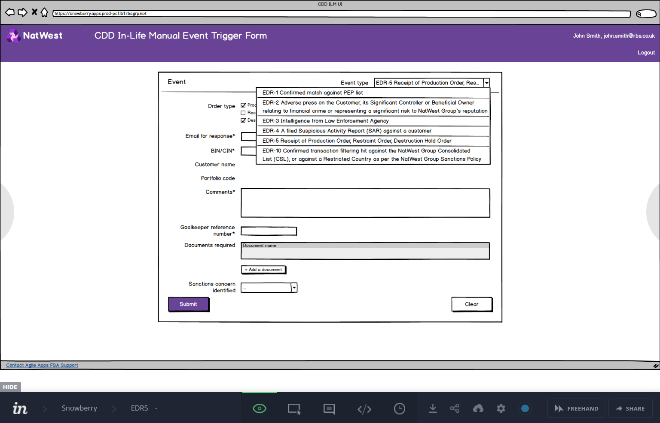
What we did — Agile Apps
Used existing static Balsamiq based mock-ups.
Visualized workflow by adding interactive elements in the mock-ups via InVision.
Allowed multiple stakeholders to effectively, real-time collaborate in the design review process.
Captured real-time feedback from stakeholders to refine the prototypes.

Slide 8
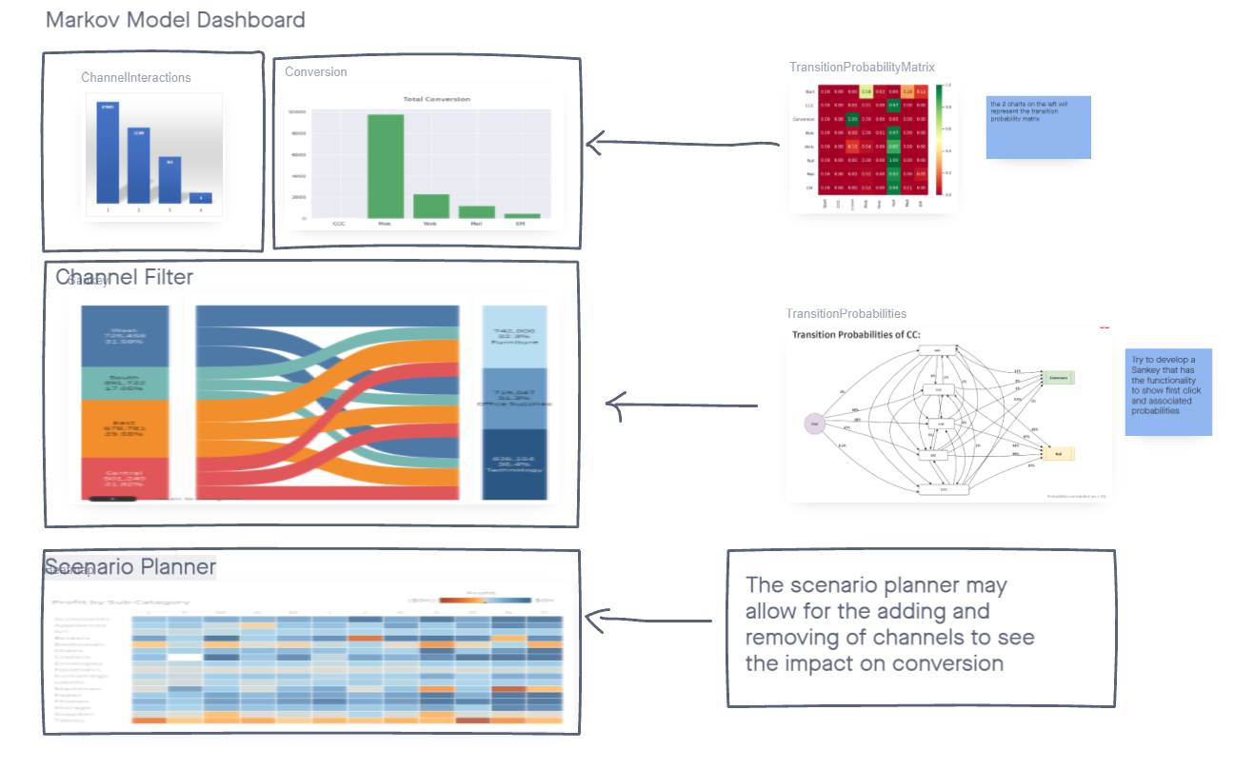
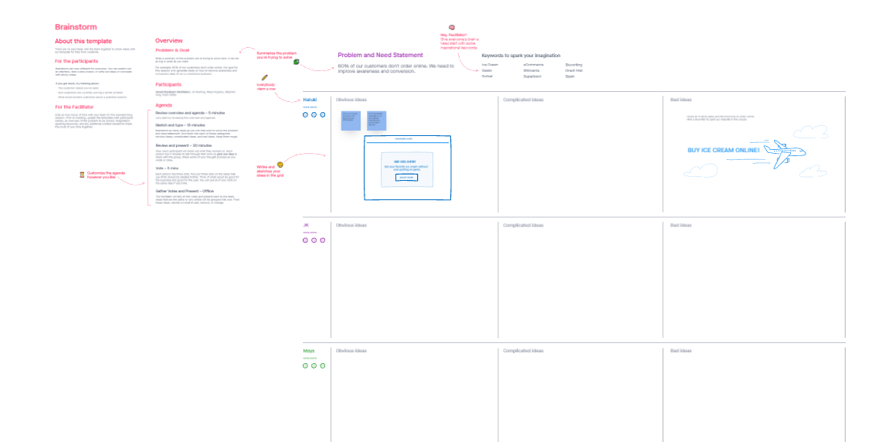






What we did in spike – Analytics MI
Investigated the capabilities of the tool:
Prototype
Boards
Freehand
Developed a prototype dashboard
Created Collaboration templates
Used boards to display visualisations
Collaborated with Colleagues on design

Slide 9
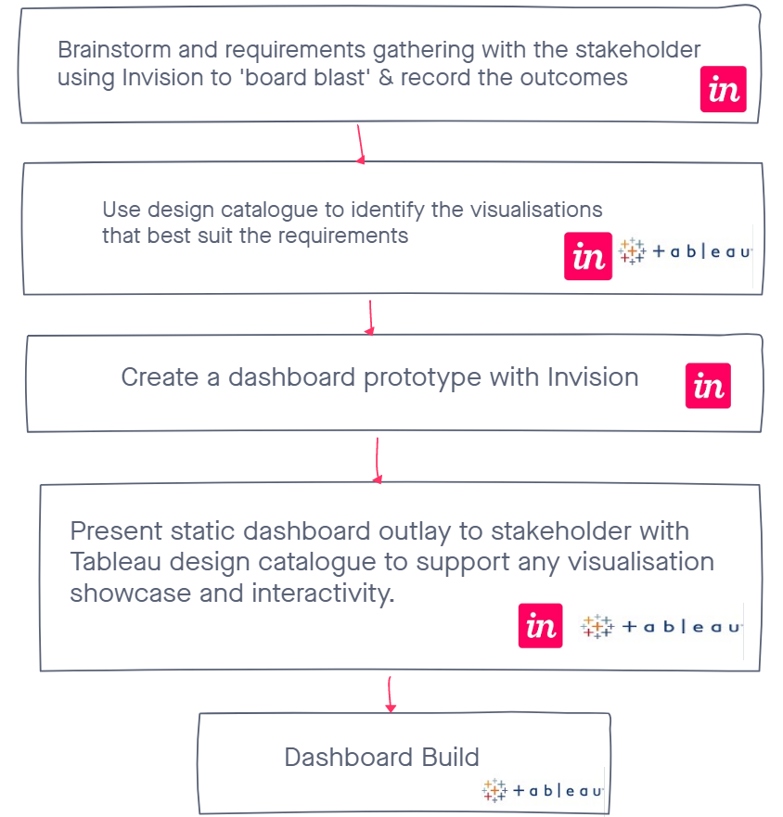
Proposed Analytics MI design Operating model
Model built using Invision

Slide 10


Spike results
Invision is a good collaboration tool when creating visualisations and allows multiple users to edit at the same time.
Invision would allow for an interactive session with stakeholders to gather requirements.
Licences are not required to allow for collaboration with stakeholders.
Spin off use in general Idea co-authoring and collaboration, Eg: Team building activity templates
Invision has to be used on Microsoft Edge (for creators and viewers)
Invision Studio installation issues identified and being worked through with VCSe teams

Slide 11
FOR INTERNAL USE ONLY
Thank you
Information classiﬁcation: Internal

